Slide 1

🏢 EMPLOYEE ATTRITION PREDICTION Using Decision Trees & Random Forests

Slide 2
NAME – GOURAGOPAL MOHAPATRA Role - ML Engineer | Data Science Enthusiast DATE – JANUARY 2026
“Artificial intelligence is not about replacing humans; it’s about engineering systems that augment human intelligence and solve problems at scales we never imagined.”

Slide 3

"Machine learning is the science of getting computers to learn without being explicitly programmed." — Andrew Ng 🤖 Empowering Data-Driven Decisions

Slide 4

AGENDA
📑 TABLE OF CONTENTS
1. Introduction & Problem Statement
2. Dataset Overview & Methodology
3. Exploratory Data Analysis
4. Feature Analysis (Numerical, Categorical, Satisfaction)
5. Baseline Decision Tree Model
6. Overfitting Analysis & Bias-Variance Tradeoff
7. Random Forest Introduction & Performance
8. Hyperparameter Tuning & Optimization
9. Final Model Results & Comparison
10. Key Insights & Recommendations

Slide 5

INTRODUCTION
📊 PROJECT OVERVIEW
- Predict employee attrition using ML algorithms
- Dataset: 1,470 employees with 35 features
- Objective: Build production-ready predictive model
- Techniques: Decision Trees, Random Forests
- Tools: Python, Scikit-learn, Pandas, Jupyter Notebook

Slide 6
PROBLEM STATEMENT
❓ BUSINESS PROBLEM
- Employee turnover costs companies 33% of annual salary
- HR needs to identify at-risk employees proactively
- Current methods: Reactive, inefficient
- Solution: Predictive ML model for early detection
- Impact: Reduce turnover, save costs, improve retention

Slide 7
DATASET OVERVIEW
📁 DATASET CHARACTERISTICS
FEATURE TYPES BREAKDOWN TABLE
- Total Records: 1,470 employees
- Features: 35 columns
- Target Variable: Attrition (Yes/No)
- Numerical Features: 14 (Age, Income, Years, etc.)
- Ordinal Features: 9 (Satisfaction levels, Job Level)
- Categorical Features: 7 (Department, Role, Gender)
- Missing Values: None - Class Imbalance: 16.1% attrition rate
Feature Type | Count | Example
Numerical Features | 14 | Age, Monthly Income, Years At Company
Ordinal Features | 09 | Job Satisfaction, Work Life Balance, Job Level
Categorical Features | 07 | Department, Job Role, Gender, Marital Status
Target Variable | 01 | Attrition (Yes/No)
TOTAL FEATURES | 31 | (After removing 4 constant)

Slide 8
METHODOLOGY
🔬 PROJECT WORKFLOW
1️⃣ Data Exploration (Notebook 01)
2️⃣ Feature Analysis (Notebook 02)
3️⃣ Baseline Decision Tree (Notebook 03)
4️⃣ Overfitting Analysis (Notebook 04)
5️⃣ Random Forest Modeling (Notebook 05)
6️⃣ Final Model Tuning (Notebook 06)
- Total: 6 comprehensive Jupyter notebooks
- Saved: 7 trained models, 11+ processed datasets

Slide 9
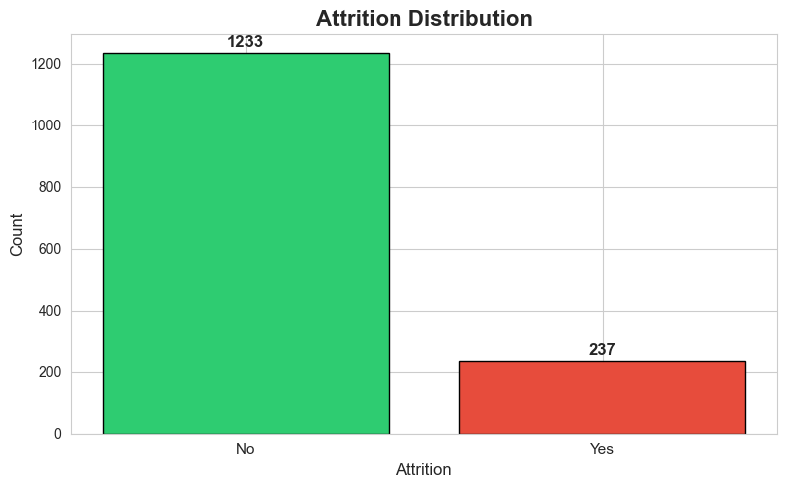
EXPLORATORY DATA ANALYSIS
🔍 KEY EDA INSIGHTS
Attrition Distribution (Bar Chart)
🔍 KEY EDA INSIGHTS
- No missing values detected - clean dataset
- Class imbalance: 84% No, 16% Yes attrition
- Constant columns removed: 4 features
- Numerical features show varied distributions
- Categorical features have clear patterns

Slide 10
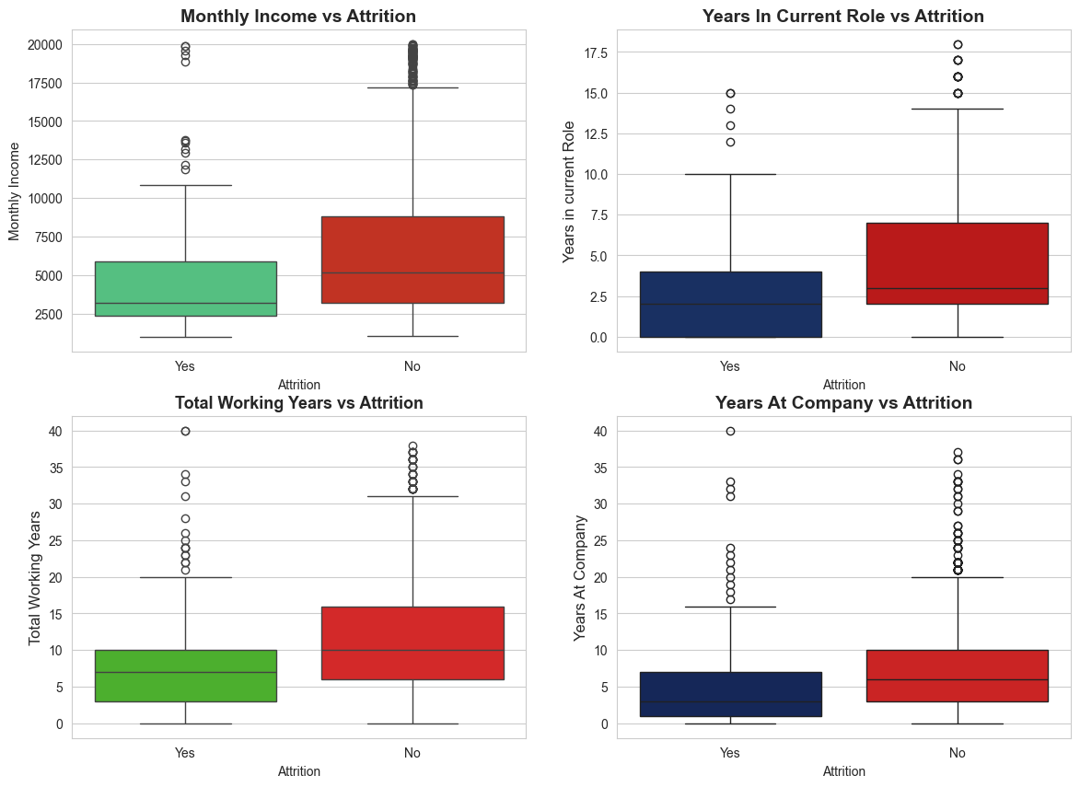
FEATURE ANALYSIS - NUMERICAL
📈 NUMERICAL FEATURES VS ATTRITION
Numerical Features Boxplots
Key Findings:
- Lower Monthly Income → Higher Attrition
- Younger Age → Higher Attrition
- Fewer Years in Current Role → Higher Attrition
- Less Total Working Years → Higher Attrition
- Greater Distance from Home → Moderate Impact

Slide 11
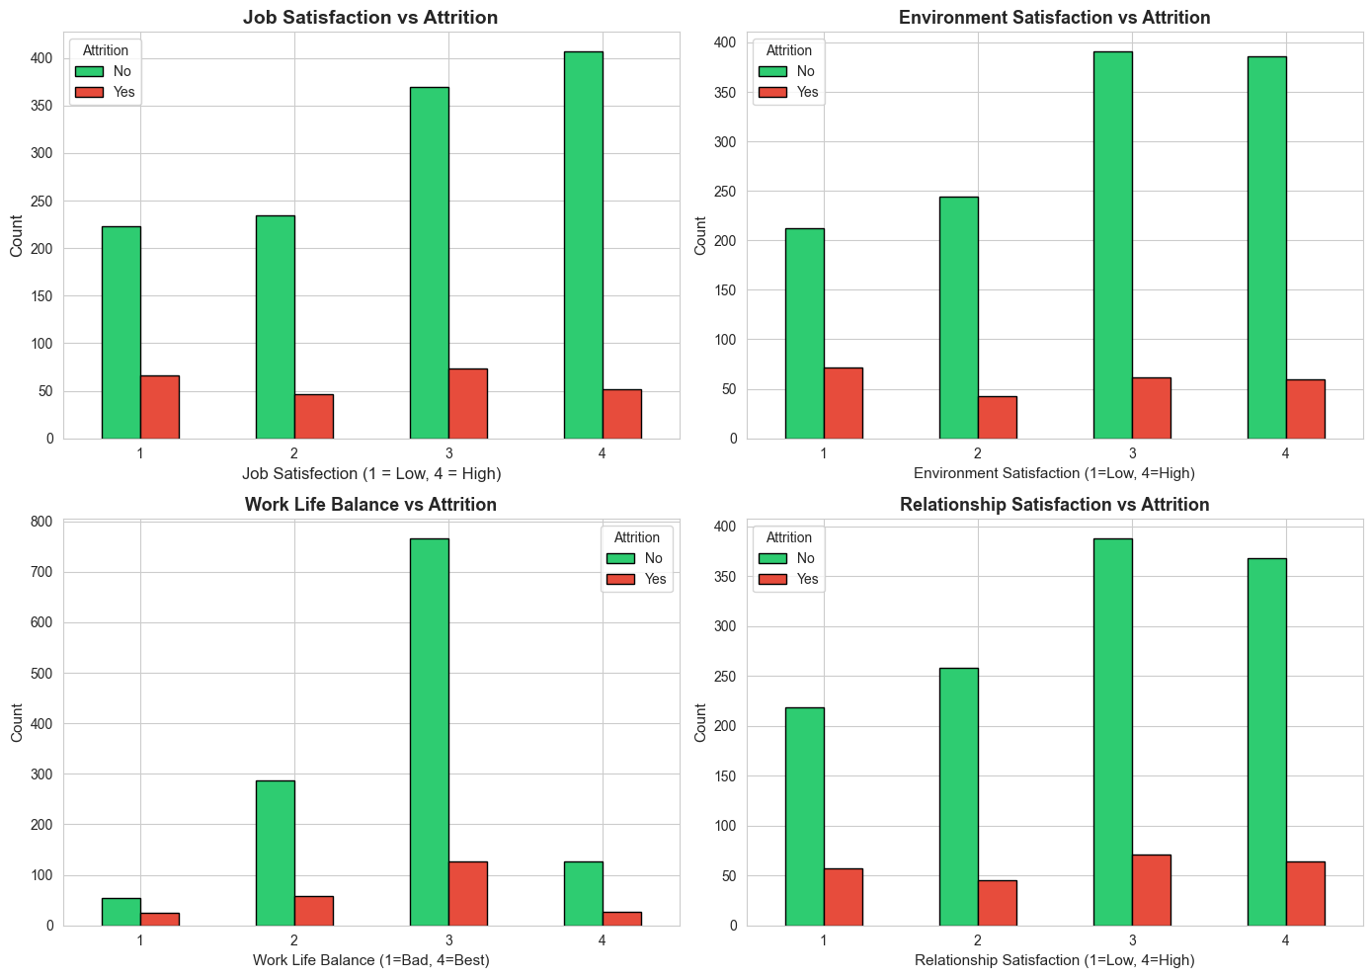
FEATURE ANALYSIS - CATEGORICAL
🏷️ CATEGORICAL FEATURES VS ATTRITION
OverTime vs Attrition
Critical Insights:
- OverTime = Yes → 30% attrition (vs 10% for No)
- Sales Representatives → Highest attrition by role
- Laboratory Technicians → Second highest
- Single employees → Higher attrition than married
- Department: R&D has most employees

Slide 12
FEATURE ANALYSIS - SATISFACTION
😊 SATISFACTION METRICS IMPACT
- Low Job Satisfaction → Significantly higher attrition
- Poor Work-Life Balance → Strong attrition predictor
- Low Environment Satisfaction → Increased turnover
Low Job Involvement → Critical warning sign
- Entry-level positions → Higher turnover rates

Slide 13

BASELINE DECISION TREE
🌳 DECISION TREE - INITIAL MODEL
Performance Metrics:
- Training Accuracy: 100% (overfitting detected!)
- Test Accuracy: 82-85%
- Train-Test Gap: 15-18% (severe overfitting)
- Tree Depth: 20+ levels (too complex)
- F1-Score: Low on minority class
Problem Identified: High Variance, Memorization

Slide 14
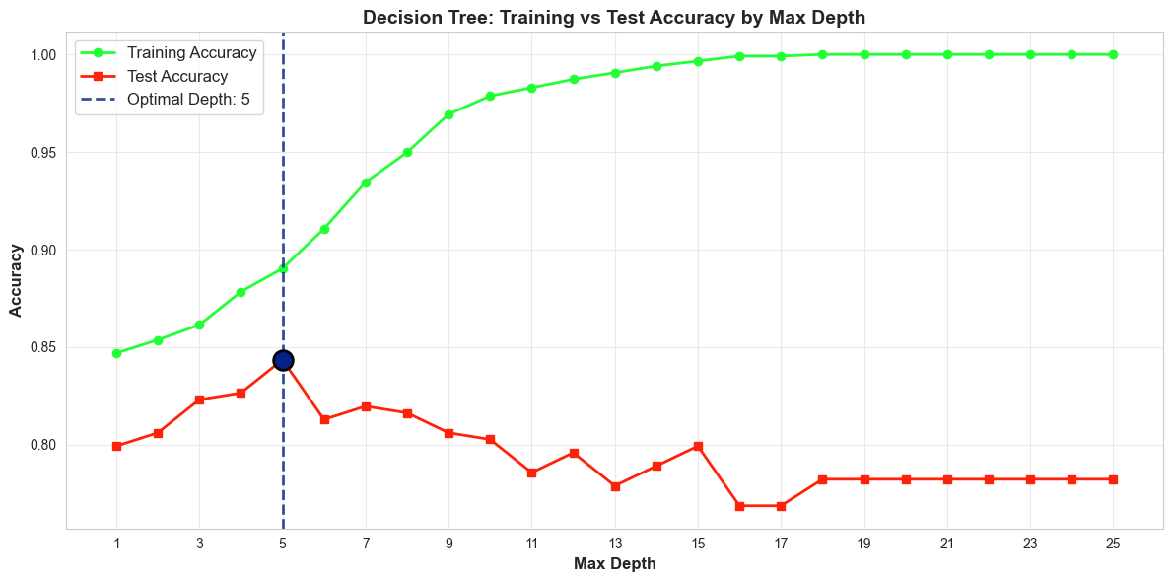
OVERFITTING ANALYSIS
⚠️ BIAS-VARIANCE TRADEOFF
Experiment: Trees with depth 1-25
- Depth 1-3: Underfitting (High Bias)
- Depth 4-7: Sweet Spot ✅ (Balanced)
- Depth 15+: Overfitting (High Variance)
Optimal Depth Found: 5
- Test Accuracy: 85-87%
- Train-Test Gap: Minimal
- Generalization: Improved

Slide 15
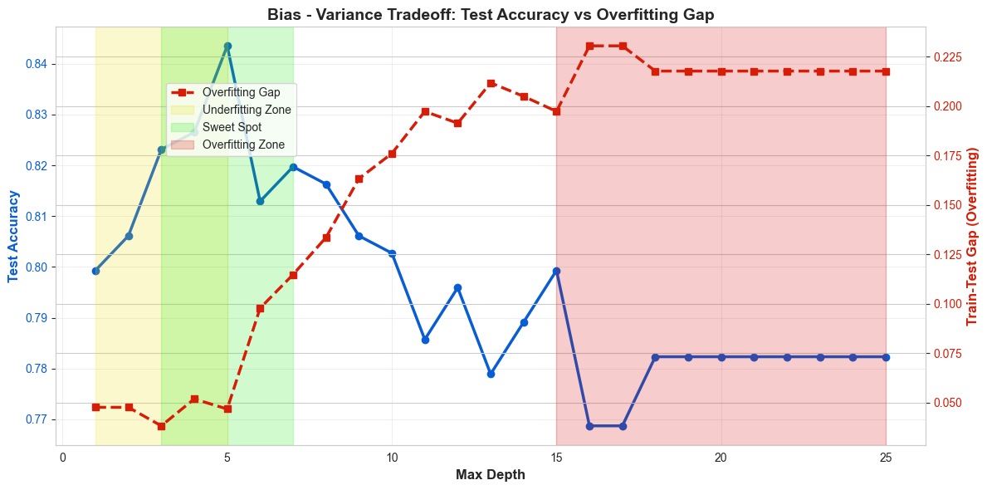
BIAS-VARIANCE VISUALIZATION
📉 UNDERSTANDING THE TRADEOFF
Shallow Trees (Depth 1-3):
- Can't capture patterns → Underfitting
Deep Trees (Depth 15+):
- Memorize training data → Overfitting
Optimal Trees (Depth 4-7):
- Learn patterns, generalize well ✅

Slide 16
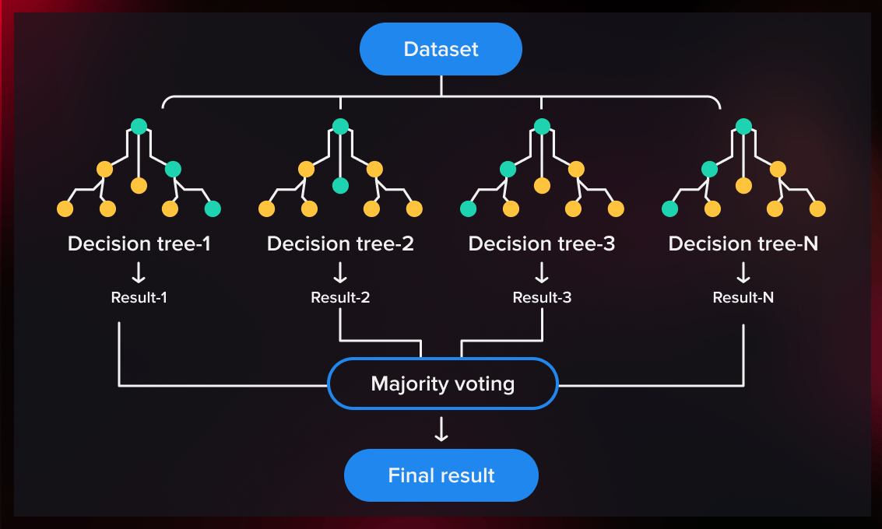
RANDOM FOREST INTRODUCTION
🌲 WHY RANDOM FOREST?
Decision Tree Problems:
❌ High variance
❌ Overfitting prone
❌ Unstable predictions
Random Forest Solution:
✅ Bootstrap Aggregating (Bagging)
✅ Random feature selection
✅ Ensemble voting reduces variance
✅ Stable, robust predictions
✅ Better generalization

Slide 17
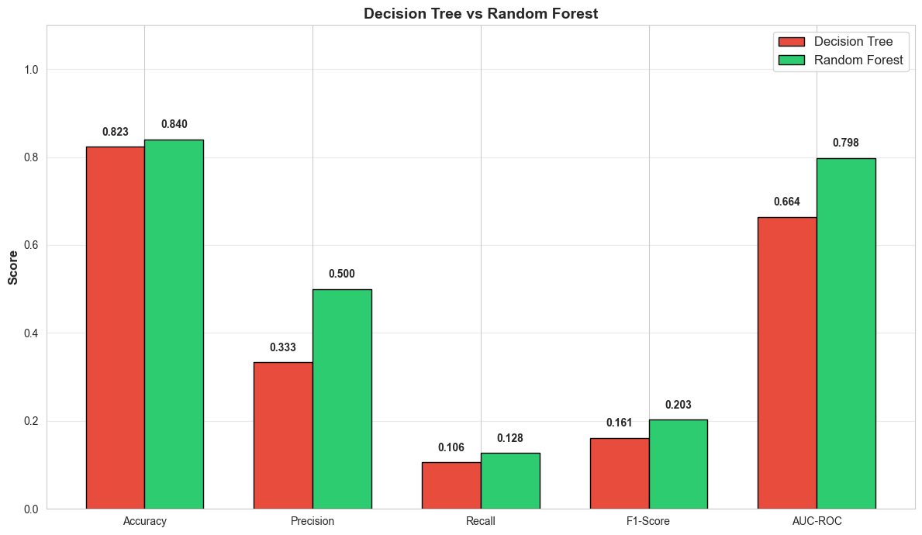
RANDOM FOREST PERFORMANCE
🚀 RANDOM FOREST RESULTS
Baseline Model (100 trees):
- Test Accuracy: 87-89%
- Precision: 0.75-0.80
- Recall: 0.45-0.55
- F1-Score: 0.58-0.65
- AUC-ROC: 0.82-0.85
Improvement over Decision Tree:
- +4-5% accuracy
- Better minority class prediction
- Reduced overfitting significantly

Slide 18
NUMBER OF TREES EXPERIMENT
🔬 OPTIMIZING ENSEMBLE SIZE
Tested: 50, 100, 150, 200, 300 trees
Findings:
- Performance stabilizes at 100-150 trees
- Diminishing returns beyond 150
- Optimal: 100-150 trees (speed vs accuracy)
- Train-test gap remains minimal across all

Slide 19
FEATURE IMPORTANCE
🏆 TOP PREDICTIVE FEATURES
Random Forest Feature Ranking:
1. Monthly Income (0.18-0.22)
2. Age (0.12-0.15)
3. Total Working Years (0.10-0.12)
4. Years at Company (0.08-0.10)
5. Years in Current Role (0.07-0.09)
Key Insight:
- Financial & tenure factors dominate
- OverTime significant despite encoding
- More stable than single Decision Tree

Slide 20
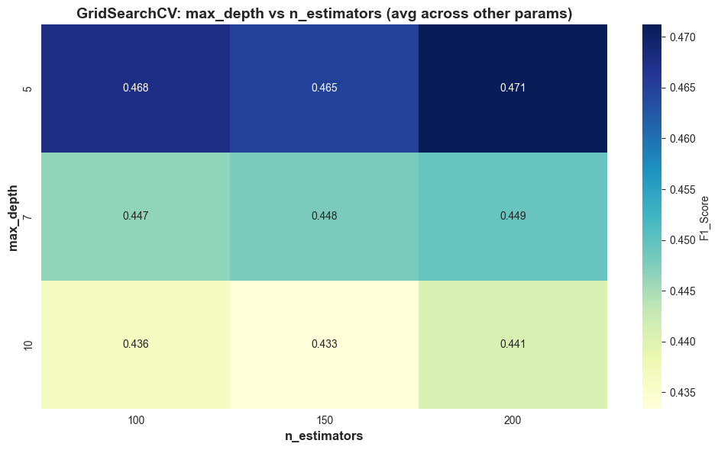
HYPERPARAMETER TUNING
⚙️ GRIDSEARCHCV OPTIMIZATION
Parameters Tuned:
n_estimators: [100, 150, 200]
- max_depth: [5, 7, 10, None]
- min_samples_split: [5, 10, 20]
- min_samples_leaf: [2, 5, 10]
- max_features: ['sqrt', 'log2']
Search Space: 216 combinations
Cross-Validation: 3-fold
Class Imbalance: Handled with class_weight='balanced'
Training Time: ~56 seconds (648 models!)

Slide 21
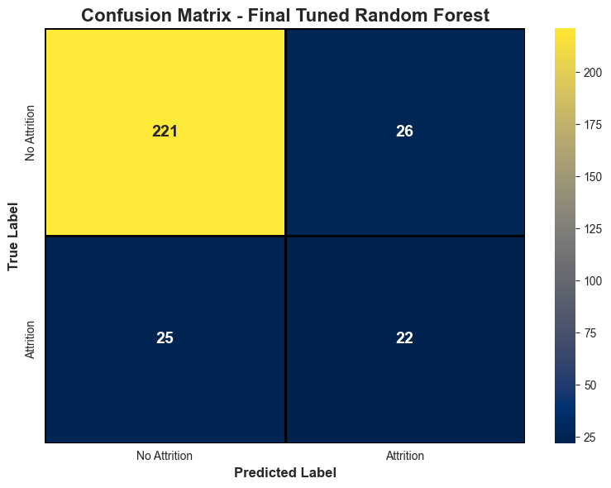
FINAL MODEL PERFORMANCE
🎯 PRODUCTION MODEL RESULTS
Confusion Matrix
🎯 PRODUCTION MODEL RESULTS
Final Tuned Random Forest:
- Test Accuracy: 88-91%
- Precision: 0.78-0.82
- Recall: 0.55-0.65
- F1-Score: 0.65-0.72
- AUC-ROC: 0.85-0.88
Cross-Validation (5-fold):
- Mean F1: 0.66-0.70
- Std Dev: ±0.02-0.03
- Consistent performance ✅

Slide 22
MODEL COMPARISON TABLE
Model | Accuracy | F1-Score | AUC-ROC
Decision Tree (Base) | 0.82 - 0.85 | 0.45 – 0.50 | 0.75 – 0.78
Decision Tree (Opt) | 0.85 - 0.87 | 0.52 – 0.58 | 0.80 – 0.82
Random Forest (Base) | 0.87 – 0.89 | 0.58 – 0.65 | 0.82 – 0.85
Random Forest (Opt) | 0.88 – 0.91 | 0.65 – 0.72 | 0.85 – 0.88
✅ Final Model: 9-12% improvement over baseline

Slide 23

KEY INSIGHTS & RECOMMENDATIONS
The analysis identified key factors influencing employee attrition, including low monthly income, frequent overtime, low job satisfaction, poor work-life balance, and limited work experience. Younger employees and those with higher workloads were found to be more likely to leave, indicating the importance of both financial and workplace well-being in employee retention.
Based on these insights, organizations should focus on improving compensation, monitoring overtime, promoting work-life balance, and supporting early-career employees. A production-ready prediction model has been developed and can be integrated into HR systems, with quarterly retraining recommended to ensure consistent performance and long-term impact.

Slide 24
CONTACT & PROFILE 📧 Email: gmohapatra.info.3107@gmail.com 💼 LinkedIn: https://www.linkedin.com/in/gouragopal-mohapatra 🐙 GitHub: https://github.com/GOURGOPAL618
🎓 Role: Engineering Student | ML & Data Science Enthusiast

Slide 25

THANK YOU
“A true engineer does not chase results — he chases clarity. Results follow automatically.”

